Slide 1

Complex decision-making in pediatric pseudotumor cerebri (syndrome)
Daniel Tibussek, MD, MSC
Clinical Frontiers in Pediatric Neurology 2019
October 17th; Ljubljana, Slovenia
Notes:
I will use the term PTCS, see Neurology: Friedman et al

Slide 2

These slides will be available online!
http://pseudotumor.info

Slide 3
Disclosures
none

Slide 4
Overview
2 Cases
Case discussions
  What is intracranial hypertension?
  Diagnostic difficulties
  How do we monitor PTCS cases?
  When and why escalate
Test questions
Summary and Outlook

Slide 5
Case 1

Slide 6
Case 1
7 yrs, non-obese otherwise healthy boy
Subjective visual disturbances since 6 wks
Papilledema (“disc margin blurred, R>L”)
Normal visual acuity, visual fields OK
normal MRI
LP (without sedation):
Opening pressure 37 cm H2O
After 4 wks Acetazolamide 10 mg/kg, no adverse effects, Base excess – 8,4 mmol/l
Does not c/o visual disturbances any more

Slide 7
Case 1 con´t
However, still papilledema after 2 months
Visual function still normal
Acetazolamide increased to 25 mg/kg/d
4 weeks later, significant side effects
Re-LP: opening pressure 35 cm H2O
E-mail to Dr Tibussek:
„Doctors talk about VP-shunt“

Slide 8
What do you think?

Slide 9
Points to discuss
Does this patient fulfill PTCS criteria?
Any comments on LP without sedation in a 7 years old?
3) Is this really papilledema?
4) When and why would we ever consider operation in pediatric PTCS patients?

Slide 10
Diagnostic criteria: What is Pseudotumor cerebri in 2019?

Slide 11
Test yourself 1)
What is the upper limit of normal of CSF opening pressure?
  A) 25 cm H₂O
  B) 28 cm H₂O
  C) 20 cm H₂O
  D) There is no such thing as the
  upper limit of normal

Slide 12
Definition of Pseudotumor cerebri syndrome
A. Papilledema
B. Normal neurologic examination except for cranial nerve abnormalities
C. Neuroimaging: Normal brain parenchyma
D. Normal CSF composition
E. Elevated lumbar puncture opening pressure
Adapted from: Friedman DI et al. Revised diagnostic criteria for the pseudotumor cerebri syndrome in adults and children. Neurology; 2013;81:1159–1165.

Slide 13
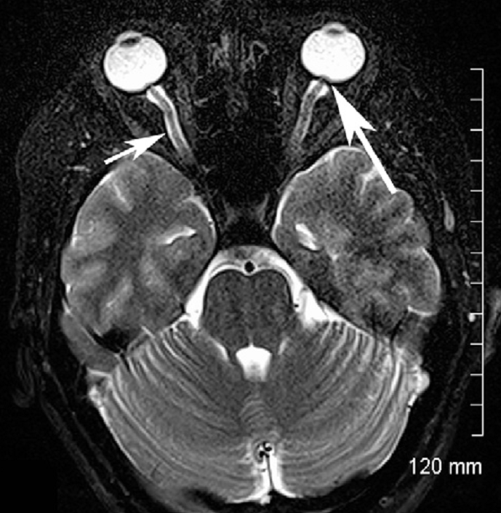
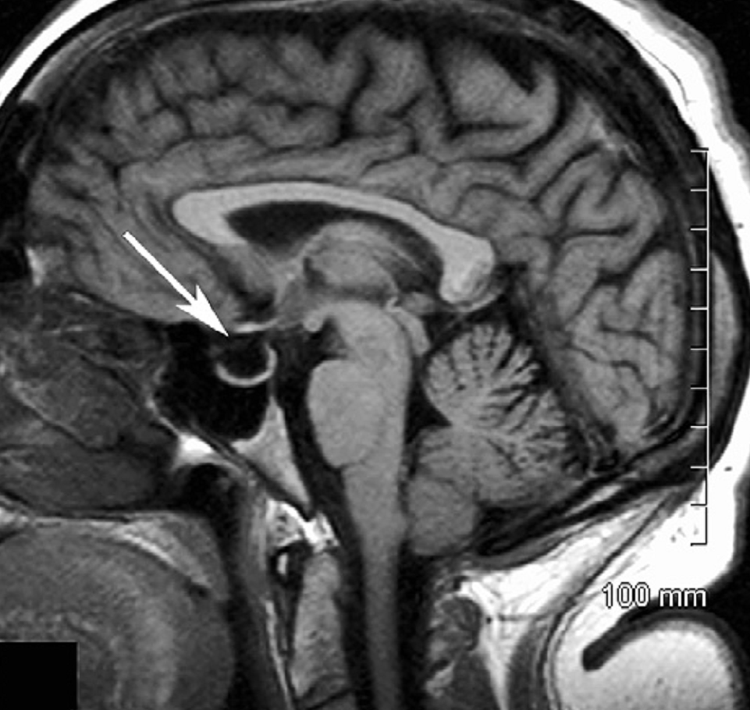
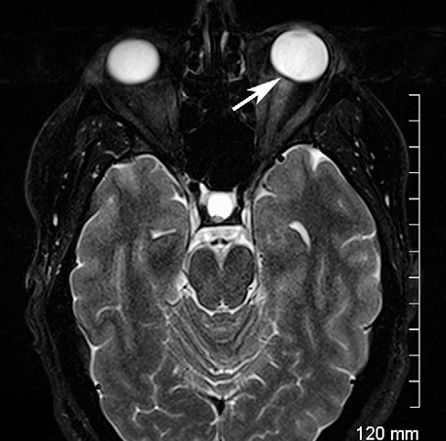
partially empty sella
optic nerve sheath distension
flattening of posterior globe
Maralani et al. Clinical Radiology 2012; 67:656-663

Slide 14
Definition of Pseudotumor cerebri
A. Papilledema
B. Normal neurologic examination except for cranial nerve abnormalities
C. Neuroimaging: Normal brain parenchyma
D. Normal CSF composition
E. Elevated lumbar puncture opening pressure
BUT: what is elevated opening pressure?
Adapted from: Friedman DI et al. Revised diagnostic criteria for the pseudotumor cerebri syndrome in adults and children. Neurology; 2013;81:1159–1165.

Slide 15
Diagnostic Criteria for Pseudotumor Cerebri Syndrome
Elevated lumbar puncture opening pressure (>250 mm CSF in adults and >280 mm CSF in children
[250 mm CSF if the child is not sedated and not obese])
Different upper limits for subgroups are CLINCALLY NOT HELPFUL.
POOR SUPPORTIVE EVIDENCE!
Friedman DI et al. Revised diagnostic criteria for the pseudotumor cerebri syndrome in adults and children. Neurology; 2013;81:1159–1165.

Slide 16
Opening Pressure Distribution (N = 197)
These are „normal“ children! NO PTCS!
11.5
(10th %)
28
(90th %)
Frequency
(Opening Pressure cm H₂O)
Avery et al. N Engl J Med 363;891-3
Notes:
16

Slide 17
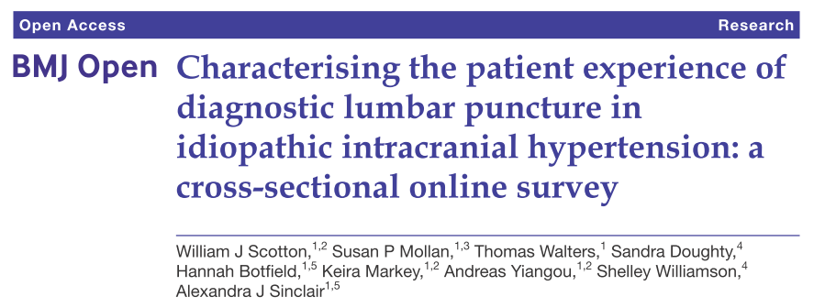
LP without sedation/analgesia?
„the majority of these patients are experiencing significant morbidity from pain and anxiety” ADULTS!!!
doi: 10.1136/bmjopen-2017-020445
Notes:
There is a widespread and wrong perception of doctors that LP is not a stressful procedure for patients

Slide 18
LP in Procedural Sedation and Analgesia? YES!
50% of PTCS children in Germany did not get PSA for diagnostic LP
Clear advantages of LP in PSA:
No pain >> more reliable pressure
No trauma (repeated LP likely!)
Higher success rate!!
Comparability better if always same PSA regime used
Tibussek et al. Klin Padiatr 2012; 224: 40–42

Slide 19
Back to the case questions:
Does this patient fulfill PTCS criteria?
Well, actually yes, but…
Any comments on LP without PSA in a 7 years old?
Yes, see above,
in addition, …

Slide 20
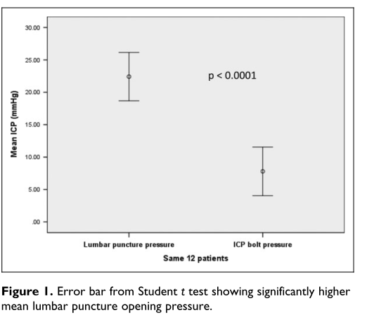
Lumbar Puncture Opening Pressure Is Not a Reliable Measure of Intracranial Pressure in Children. N=12
Journal of Child Neurology 2015, Vol. 30(2) 170-173.
Notes:
Studie von Patienten, die zur Shuntanlage vorgestellt wurden. MERKE: unbedingt Reevaluation vor OP!!! Erfahrungen aus der Erwachsenenmedizin ähnlich.

Slide 21
Lumbar Puncture Opening Pressure Is Not a Reliable Measure of Intracranial Pressure in Children. N=12
„Lumbar puncture therefore significantly overestimates the intracranial pressure in children.”
These patients were referred for VP shunt!
Journal of Child Neurology 2015, Vol. 30(2) 170-173.
Notes:
Studie von Patienten, die zur Shuntanlage vorgestellt wurden. MERKE: unbedingt Reevaluation vor OP!!! Erfahrungen aus der Erwachsenenmedizin ähnlich.

Slide 22
Case 1: Back from ophthalmology tertiary center…
8 months after primary PTCS diagnosis:
  „The eye doctor now questions the diagnosis of PTCS. Ultrasound suggest drusen.“
  Fluorescence confirmed it!!
This child did NOT have PTCS!
Was scheduled for surgery already!
What would have been indication for surgery anyway?
Capo et al. Optic nerve abnormalities in children: A practical Approach. J AAPOS 2011;15:281-290
Notes:
So, better refer patient for second opion…

Slide 23
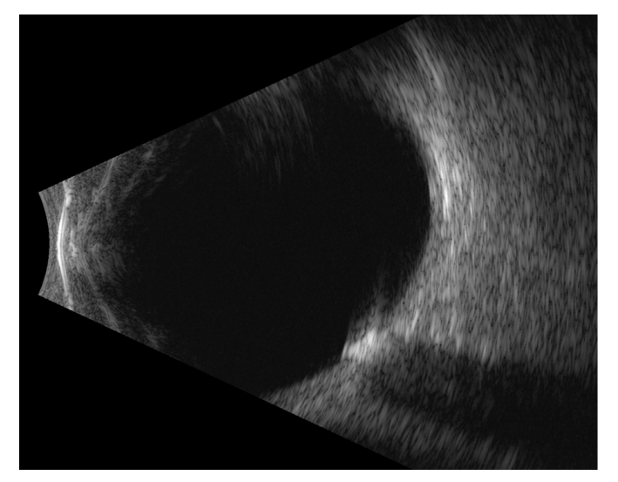
Optic drusen: Prevalence 0.4%
Chang et al. Survey of Ophthalmology , 2016;61;6 :745 – 758
Palmer et al: https://doi.org/10.1080/01658107.2018.1444060
Notes:
Wenn Gesichtsfelddefekte auftreten, kann es ausschliesslich durch Drusen bedingt sein!

Slide 24
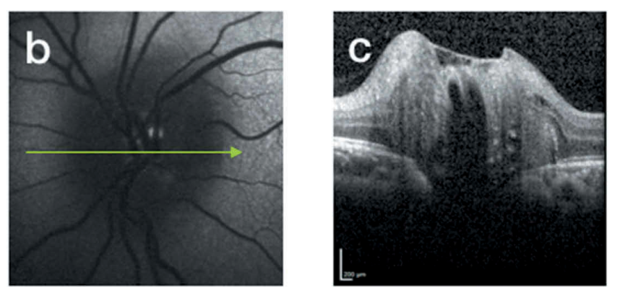
Buried Optic Drusen
Autofluorescence Enhanced depth imaging (EDI) OCT
Palmer E et al. Optic Nerve Head Drusen: An Update https://doi.org/10.1080/01658107.2018.1444060
Notes:
Will be more often used in future…

Slide 25
Problems with Papilledema
Interobserver agreement on grading the severity of papilledema is poor among experts
Distinguishing papilledema from pseudopapilledema can be difﬁcult (e.g. buried drusen, Pseudopapilledema hyperopica,…)
The same patient can have optic drusen AND intracranial hypertension!!
Experienced pediatric neuroophthalmologists are your most important partner when treating pediatric PTCS patients!
Notes:
These statements are made by expert neuroophthalmologists. I frequently ecounter non-expert ophthalmologist, who seem to be much more confindent…

Slide 26
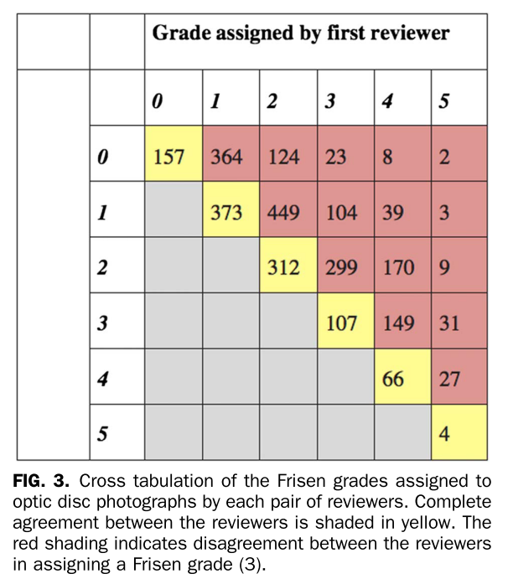
Complete agreement amongst the six observers was
noted in just
1.6% of discs assessed by
Frisen grading
Sinclair AJ, et al. Rating papilloedema: an evaluation of the Frisen classiﬁcation in idiopathic intracranial hypertension. J Neurol. 2012;259:1406 – 1412.

Slide 27
Test yourself 2)
How many children diagnosed with papilledema actually have drusen?
  A) 10%
  B) 50%
  C) 90%
  D) We do not know

Slide 28
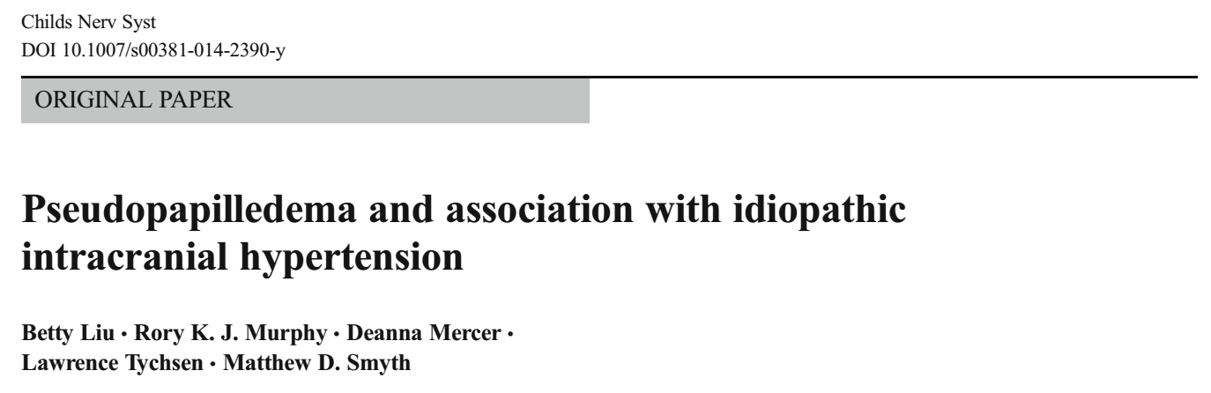
50 to 55% of children initially diagnosed with papilledema have optic disk drusen.
Chang and Pineles. Survey of ophthalmology 2016

Slide 29
Case 2

Slide 30
Case 2
13 yrs old, female, obese, BMI 32 kg/m²
History of intermittent headache, tension-type like, > 1 year
Blurred vision since 6 wks,
problems reading black board at school
Ophthalmology:
bilateral papilledema, Frisen 3, reduced visual acuity, visual fields normal

Slide 31
Case 2 con´t
MRI: normal
MRV: narrowing of both sinus transversus
LP: CSF opening pressure (OP):
  21 cm H2O
  prompt clinical improvement of headache
Normalisation of visual disturbances within days post LP, improved papilledema
No treatment b/o normal CSF OP.

Slide 32
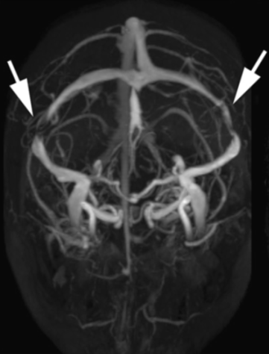
MR Venography
J Neurol Neurosurg Psychiatry. 2012 May; 83(5): 488–494.
Notes:
For didactic reasons images are taken from Publication by Biousse et al.

Slide 33
What do you think?
PTCS or not?

Slide 34
To summarize case 2
High risk patient: female, obese
Visual defects
Clear papilledema
Bilateral sinovenous stenosis: very suggestive of PTCS!
But: normal opening pressure

Slide 35
Normal opening pressure.
So why bother?

Slide 36
Remember
Measuring CSF opening pressure is a snap-shot of a dynamic process!
Deborah I Friedman:
„A high opening pressure in and of itself is neither specific nor diagnostic and must be used in context with other data from the history, examination, neuroimaging and laboratory to arrive at the correct diagnosis“
Cephalgia 2010; 30:1415-16

Slide 37
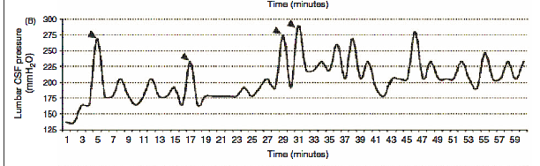
Intracranial pressure variability within 1 hour!
- Bilateral transverse sinus stenosis
- Initial LP Opening pressure < 20cm
Cephalalgia 2010 30:1419-25
Notes:
Just like blood pressure: the IP flucuates widely!

Slide 38
PTCS with CSF opening pressure
< 28 cm H₂O
Germany: 13/61 PTCS pediatrics patients
Duesseldorf: 14/75 PTCS pediatric patients
This represents 18% of the total pediatric PTCS study population
Tibussek et al. Eur J Paediatr Neurol. Probable pseudotumor cerebri complex in 25 children. Further support of a concept. doi: 10.1016/j.ejpn.2016.10.004.
Friedman DI et al. Revised diagnostic criteria for the pseudotumor cerebri syndrome in adults and children. Neurology; 2013;81:1159–1165.

Slide 39
PTCS with CSF opening pressure
< 28 cm H₂O
PTCS diagnosis possible with OP < 28 cm
There is NO cutoff value for normal CSF opening pressure
Germany: 13/61 PTCS pediatrics patients
Duesseldorf: 14/75 PTCS pediatric patients
This represents 18% of the total pediatric PTCS study population
Tibussek et al. Eur J Paediatr Neurol. Probable pseudotumor cerebri complex in 25 children. Further support of a concept. doi: 10.1016/j.ejpn.2016.10.004.
Friedman DI et al. Revised diagnostic criteria for the pseudotumor cerebri syndrome in adults and children. Neurology; 2013;81:1159–1165.

Slide 40
Case con´t
2 months later:
again blurred vision, vertigo, headache, worse than previously
CSF OP 24 cm H2O,
post LP again rapid improvement of vision
Put on acetazolamide (20 mg/kg/d)

Slide 41
Case 2 con´t
On follow-up: Ophthalmology: Normalisation of papilledema, normal visual acuity
4 months later presented again:
  Persisting headache, chronic daily
  In the meantime furosemide added
  Increasingly tired, no appetite,
  Misses weeks of school
Re-LP: OP 37 cm H₂O

Slide 42
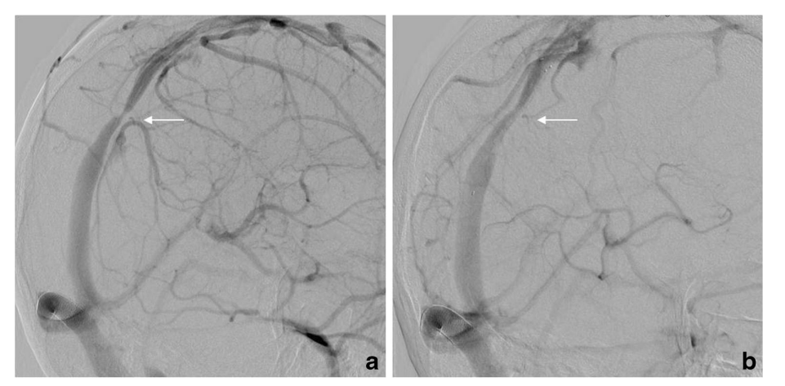
Doctors now discuss sinovenous stent!
Neuroradiology DOI 10.1007/s00234-017-1783-5

Slide 43
Questions to ask
Was MRV before AND after LP done?
Are the eyes at risk for permanent damage?
Is her headache related to intracranial hypertension at all?
Is there a need for escalating treatment?
  What is your treatment goal?
  Risk-benefit ratio?
What is the evidence for sinovenous stents in children/teenagers with PTCS?

Slide 44
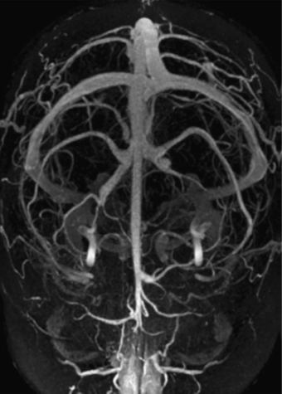
MR Venography pre post LP
J Neurol Neurosurg Psychiatry. 2012 May; 83(5): 488–494.

Slide 45
Headache as criteria for success?
A „classical“ patient shows rapid headache relief after LP
BUT
Friedman DI, Rausch A. Neurology 2002; 58:1551-1553
Notes:
Again confirmed by NORDIC Trial

Slide 46
Headache in treated PTCS
N=82
68% developed subsequent headache
Episodic tension type 30
Migraine w/o aura 20
Chronic tension type 10
Analgesic overuse headache 8
…
Friedman D, Rausch E. Neurology. 2002 May 28;58(10):1551-3.
Bruce BB, Biousse V, Newman NJ. Am J Ophthalmol 2011;152:163-169

Slide 47
„Patients with PTCS often continue experiencing headache
…despite the apparent normalization of their intracranial pressure“
Friedman D, Rausch E. Neurology. 2002 May 28;58(10):1551-3.

Slide 48
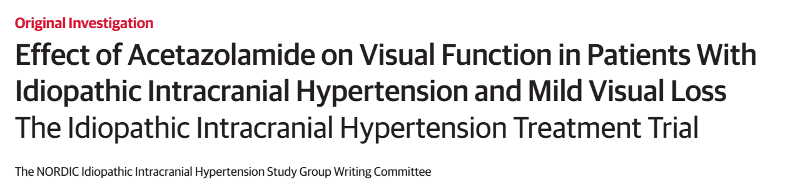
the use of acetazolamide with a low-sodium weight reduction diet, compared with diet alone, resulted in modest improvement in visual field function.
No significant treatment effects were noted with respect to headache disability
JAMA. 2014;311(16):1641-1651
Notes:
Depressing news regarding headache treatment by lowering the intracranial pressure

Slide 49
Headache: An indication for stenting?
„We do not usually recommend surgical treatment or venous stenting for patients with isolated chronic headaches and mild to moderate papilloedema without visual loss“
„because of high prevalence of associated primary headache disorders and the frequent development of chronic headache unrelated to raised ICP make the success … too unpredictable“
Anne Ducros and Valerie Biousse in Lancet Neur 2015;14:655-68

Slide 50
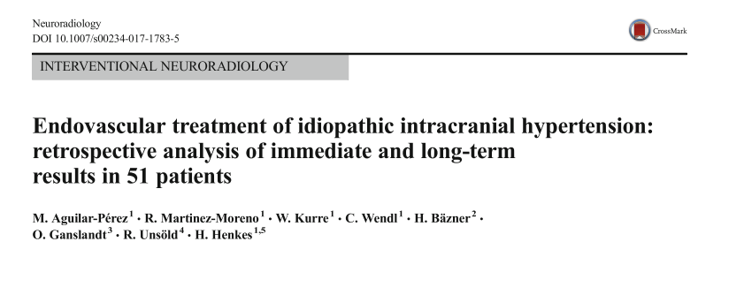
Stent: German single-center experience
N=51, mean age 40 yrs (range, 5 – 66 yrs)
“Improvement or resolution of papilledema was observed in 88% of the patients, and 84%
reported improvement or resolution of the headache.“

Slide 51
Beware of publication bias!

Slide 52
RISKS are significant!!!
Venous perforation
Subdural hemorrhage
Stent migration
In-stent thrombosis
Recurrent stenosis
Long-term antithrombotic treatment
…

Slide 53
PRIMUM NIHIL NOCERE

Slide 54
Back to the case 2

Slide 55
Case 2: Interpretation
„probable PTCS“ (OP <25 cm H2O)
Response to LP very suggestive of PTCS
Good response to treatment (re vision)
f/u LP with increased OP and headache falsely interpreted as treatment resistance
Clinical deterioration due to medication side effects
Headache not PTCS related

Slide 56
Case 2: Follow-up
After cessation of furosemide prompt clinical improvement
Back to school
Referral to headache program (multimodal therapy)
Gradually improving headache
Still remission, normal eye exam
Above all: No invasive treatment

Slide 57
Test yourself 3)
How many patients referred to me for second opinion, already scheduled for shunt, are finally being operated?
  A) 50%
  B) 25%
  C) 10%
  D) 0%

Slide 58
Expert recommendation
Before even considering any kind of invasive treatment of PTCS in children:
  1) Question your diagnosis
  2) Decide on your treatment goals
  3) Risk-benefit ratio?
  4) If in doubt: Strongly consider Continuous intracranial pressure monitoring BEFORE referring for surgery

Slide 59
What are our treatment goals?
1) Maintain/regain normal visual function
Relief headaches
Prevent unnecessary invasive treatment
Notes:
That brings me to my next point:

Slide 60
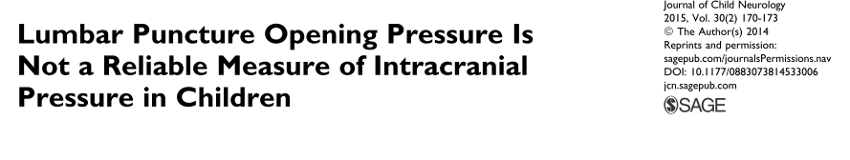
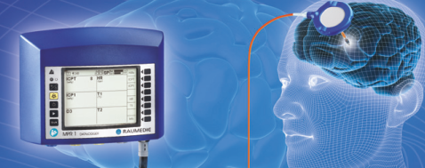
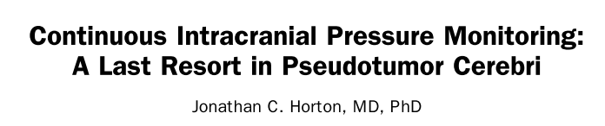
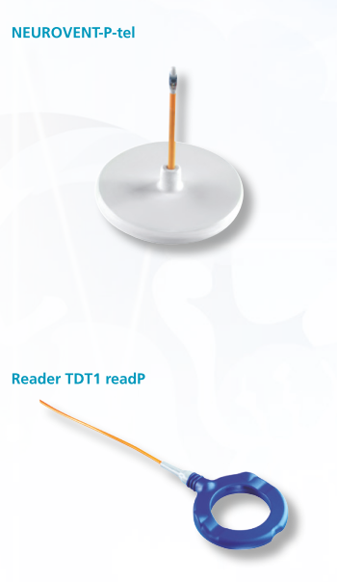
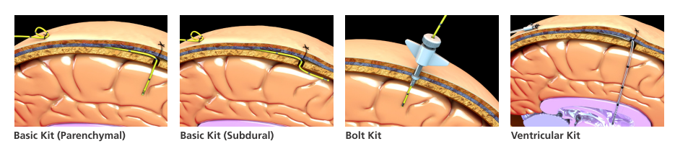
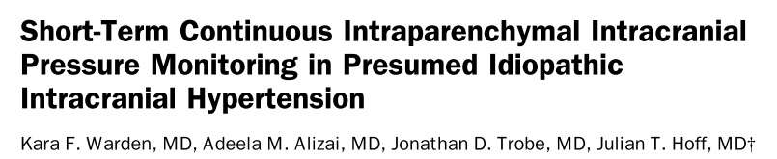
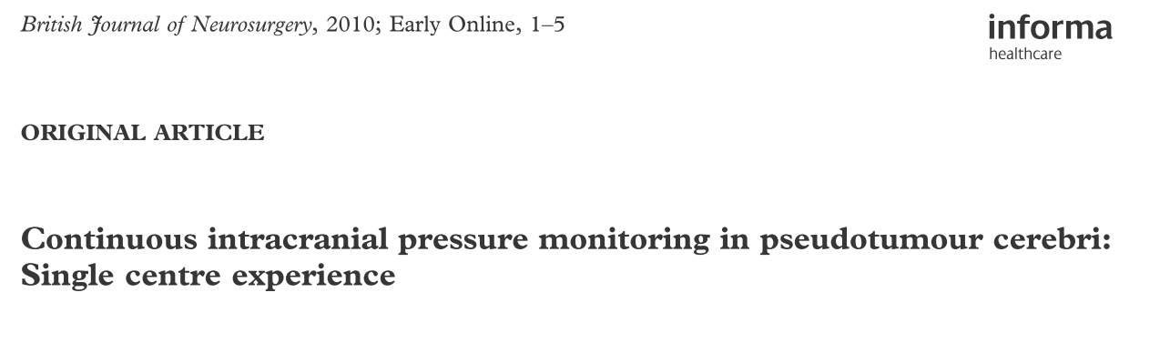
Continuous intracranial pressure monitoring.
J Neuro-Ophthalmol 2011; 31: 199-201
Journal of Neuro-Ophthalmology 2011;31:202–205
Notes:
There has been a growing interest in continuos IP monitoring in presumed PTCS cases recently…

Slide 61
Remember this!
Journal of Child Neurology 2015, Vol. 30(2) 170-173.

Slide 62
Misdiagnosis of Pseudotumor cerebri is common!
Mishra A et al. Eur J Paediatr Neurol 2007 ; 11 : 39 – 42
Colin Kennedy. Dev Med Child Neur 2006;48:83-83

Slide 63
Outlook

Slide 64
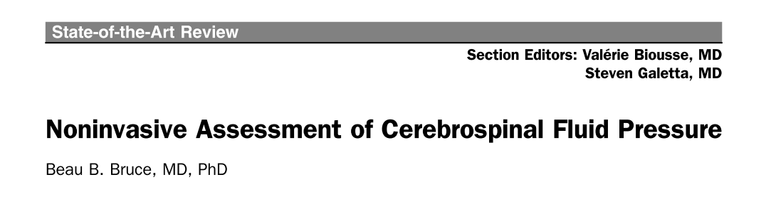
Future? Non-invasive, reliable pressure assessment?
But unfortunately:
„but so far, no individual technique clearly represents a complete solution.“
Journal of Neuro-Ophthalmology 2014;34:288 – 294

Slide 65
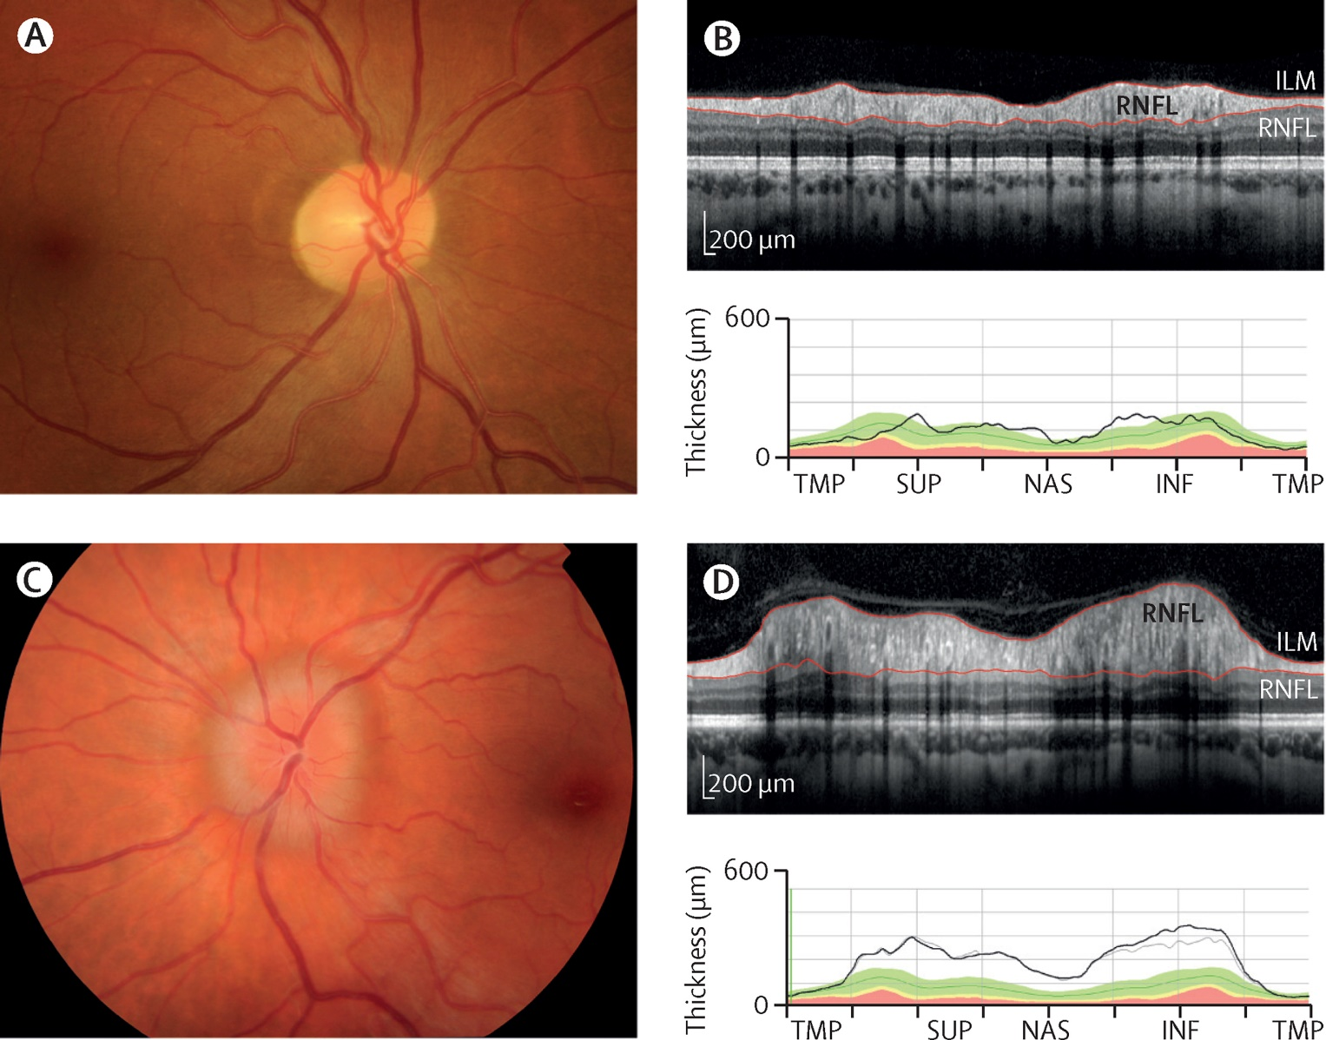

Future? Optic coherence tomography!
Figure 4
The Lancet Neurology 2016 15, 78-91DOI: (10.1016/S1474-4422(15)00298-7)
Copyright © 2016 Elsevier Ltd Terms and Conditions
https://doi.org/10.1016/j.pediatrneurol.2015.10.022
Notes:
Fundal photographs with corresponding spectral domain optical coherence tomography
Fundal photographs and optical coherence tomography can be used with clinical assessment and other visual tests for the diagnosis of papilloedema. (A) Fundal photograph and (B) corresponding optical coherence tomography showing retinal appearance in a 37-year-old woman (healthy control). (C) Fundal photograph of papilloedema (mild to moderate), with an elevated disc and 360° peripapillary halo, and (D) corresponding optical coherence tomography showing an increase in retinal nerve fibre layer thickness in a 34-year-old woman with idiopathic intracranial hypertension. INF=inferior. NAS=nasal. RNFL=retinal nerve fibre layer. SUP=superior. TMP=temporal.

Slide 66
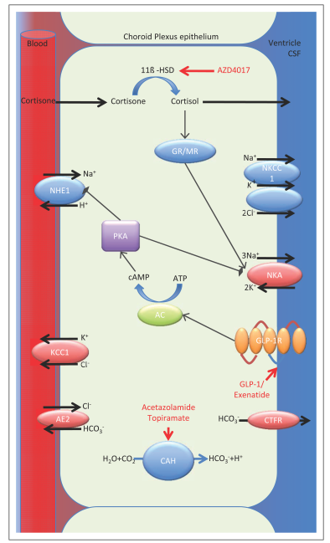
1) IIH Pressure Trial: exenatide
2) IIH Drug trial
(IIHDT): 11ß-HSD1 inhibi- tor
Future? New treatment
on the horizon:
Curr Opin Neurol 2019, 32:422–431. DOI:10.1097/WCO.0000000000000690

Slide 67
Take home messages
The doubtless diagnosis of PTCS is difficult!
Beware of diagnostic pitfalls:
  Pseudopapilledema
  Falsely elevated opening pressure
  “probable” PTCS
  Headache not related to PTCS
  Functional/psychological issues in adolescents
  Lack of drugs adherence in adolescents
Critically question diagnosis BEFORE invasive treatment.

Slide 68
Last not least:
Interdisciplinary decision!
Optimal management of IIH requires good communications between specialties
to protect the patient from unnecessary lumbar punctures and CSF diversion surgery on the one hand and avoidable visual loss on the other.
Standridge SM. Idiopathic intracranial hypertension in children: A review and algorithm. Pediatr Neurol 2010;43:377-390.

Slide 69
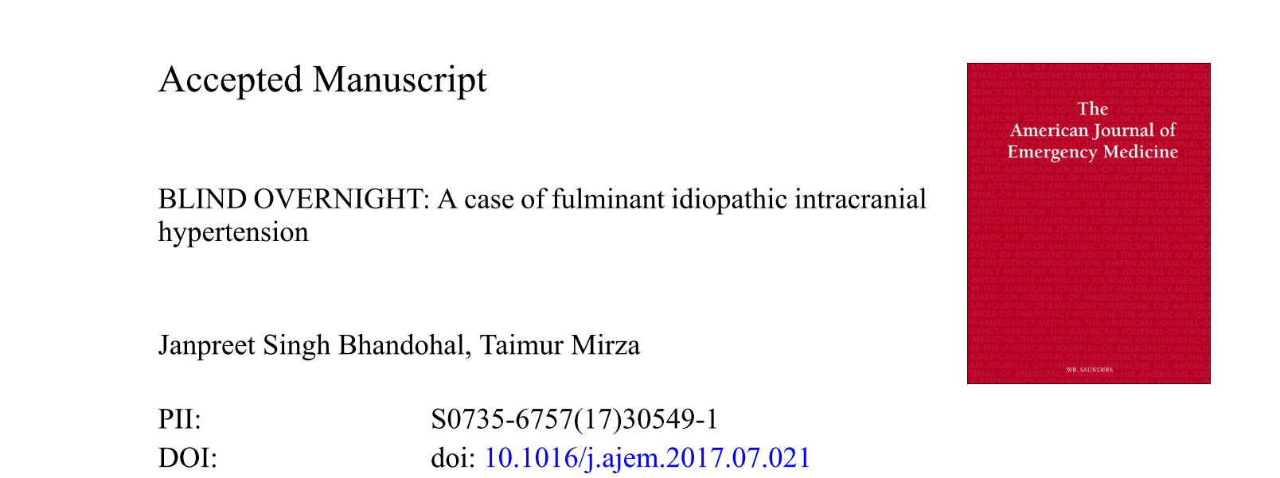
Last not least:
Interdisciplinary decision!
Optimal management of IIH requires good communications between specialties
to protect the patient from unnecessary lumbar punctures and CSF diversion surgery on the one hand and avoidable visual loss on the other.
Standridge SM. Idiopathic intracranial hypertension in children: A review and algorithm. Pediatr Neurol 2010;43:377-390.

Slide 70
Thank you very much for your attention!
Questions?

Slide 71
Supplemental material

Slide 72
Dont´t forget: differential diagnosis

Slide 73
Therapy resistence?
CAVE: Think of the unlikely!
Spinale Arachnoidalzyste
N Engl J Med 2009;361:2367-78.

Slide 74
Elevated CSF opening pressure in Pediatric Demyelinating Disease Cohort
:
„Almost 1/3 of children with inflammatory demyelinating disease have an elevated CSF opening pressure“
Pediatric Neurology 2015;52:446-449

Slide 75
Therapy: Step-wise approach
Step 1: correct potentially causal factors (medication, anaemia, hypothyroidism, ..)
Step 2: LP with CSF drainage to lower pressure >> measure post punctional pressure („closing pressure“)
Notes:
How do we achieve our treatment goals…

Slide 76
Pressure release as the only therapy
„Interestingly, it is not uncommon to observe a lasting clinical remission after a single lumbar puncture in some IIH patients“
Germany study
14/61 Patients got LP pressure as the only treatment. In 1 case succesfully as serial LP.
Bruce BB, Biousse V, Newman NJ. Update on Idiopathic Intracranial Hypertension. Am J Opthalmol 2011;152:163-169

Slide 77
Therapy: Step-wise approach
Step 3: No visual loss:
- Symptomatic headache (migraine) therapy
Step 4: Mild visual loss:
- Acetazolamide
- Furosemide
- (Topiramate)
- Weight reduction, if necessary
Liu et al. 2011 in: Neuro-Ophthalmology, Diagnosis and Management, Saunders, Elsevier

Slide 78
Therapy: Step-wise approach
Step 3: No visual loss:
- Symptomatic headache (migraine) therapy
- weight loss
Step 4: Mild visual loss:
- Acetazolamide
- Furosemide
- (Topiramate)
- Weight reduction, if necessary
Liu et al. 2011 in: Neuro-Ophthalmology, Diagnosis and Management, Saunders, Elsevier

Slide 79
Therapy: Step-wise approach
Step 3: No visual loss:
- Symptomatic headache (migraine) therapy
- weight loss
Step 4: Mild visual loss:
- Acetazolamide
- Furosemide
- (Topiramate)
- Weight reduction, if necessary
Although plausible, no evidence that topiramate is superior when headache is predominant complaint
Liu et al. 2011 in: Neuro-Ophthalmology, Diagnosis and Management, Saunders, Elsevier

Slide 80
Invasive therapy
Step 5: Severe, or progression of visual loss:
- Optic nerve sheath decompression (ONSD)
- High-dose IV steroids and acetazolamide
- Lumboperitoneal shunt for failed ONSD or intractable headache
- Bariatric surgery
Experimental: sinovenous stent

Slide 81
Invasive therapy
Step 5: Severe, or progression of visual loss:
- Optic nerve sheath decompression (ONSD)
- High-dose IV steroids and acetazolamide
- Lumboperitoneal shunt for failed ONSD or intractable headache
- Bariatric surgery
Experimental: sinovenous stent
Always critically question your diagnosis before even considering!

Slide 82
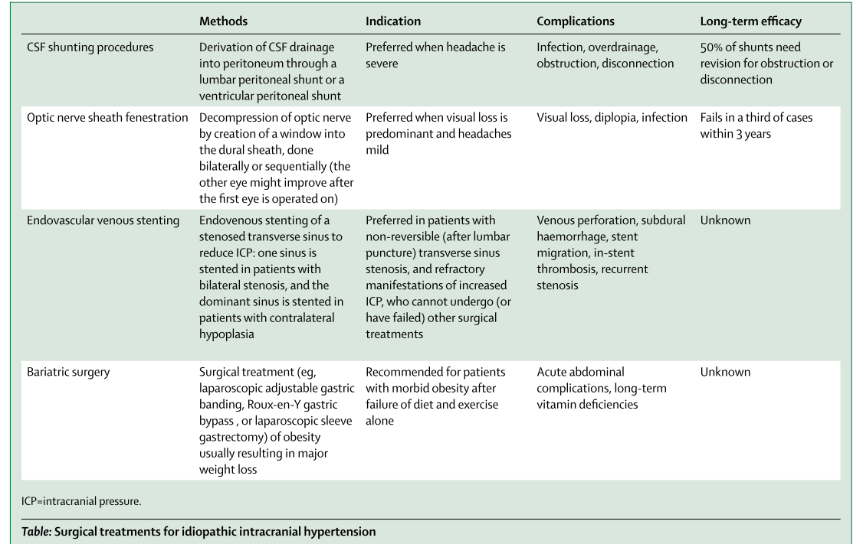
Invasive Therapies: RISKS!!
Lancet Neurol 2015; 14: 655–68
Notes:
Das ist ein Gruselkabinett

Slide 83
Further reading: suggestions.
Excellent concise review:
Novel advances in monitoring and therapeutic approaches in idiopathic intracranial hypertension. Mitchell JL^{1,2}, Mollan SP³, Vijay V^{1,2}, Sinclair AJ^{1,3,4}.
Curr Opin Neurol. 2019 Jun;32(3):422-431. doi: 10.1097/WCO.0000000000000690.
Optical Coherence Tomography in Papilledema: What Am I Missing?
Journal of Neuro-Ophthalmology 2014;34(Suppl):S10 – S17
doi: 10.1097/WNO.0000000000000162

Slide 84
How to do a lumbar puncture
https://www.youtube.com/watch?v=CKLpIDhuJrE
High BMI is the most predictive factor for an unsuccessful procedure! (doi: 10.1212/WNL.0000000000001335)
“The high failure rate in patients with BMI >35 suggests that implementing compensatory interventions such as the use of imaging guidance might be cost-effective and better tolerated by these patients.”
Continuous intracranial pressure monitoring: a last resort in pseudotumor cerebri. J Neuroophthalmol. 2011 Sep;31(3):199-201. doi: 10.1097/WNO.0b013e31822b5aec.

Slide 85
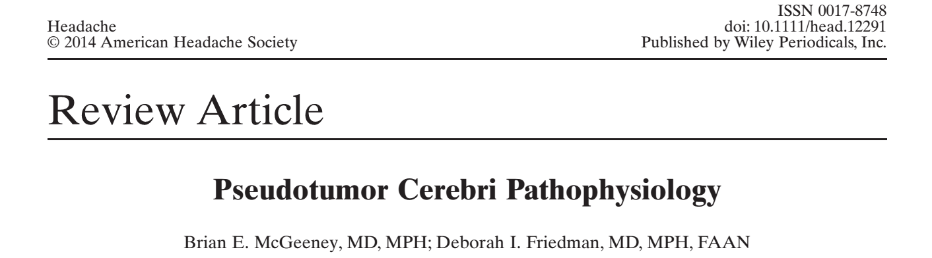
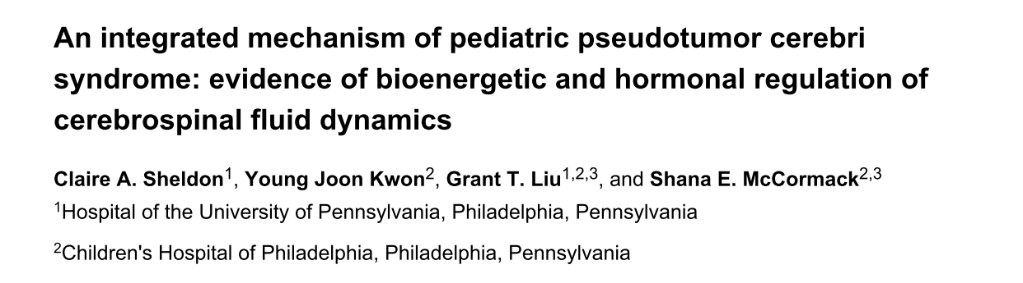
Pathophysiologie
Headache 2014;54:445-458
Pediatr Res. 2015 February ; 77(2): 282–289.
Notes:
Erstaunliche Zahl von ausführlichen Reviews. Letztlich eine Zusammenfassung von weitgehend spekulativen Ideen! Das ist noch viel schlimmer bei Kindern!

Slide 86
Biousse et al. 2016
“Mechanisms that control CSF drainage are poorly deﬁned.”
“The pathogenic mechanisms of idiopathic intracranial hypertension are still unclear”
Lancet Neurol 2016; 15: 78–91
Notes:
Um sie gleich vorneweg zu ernüchtern

Slide 87
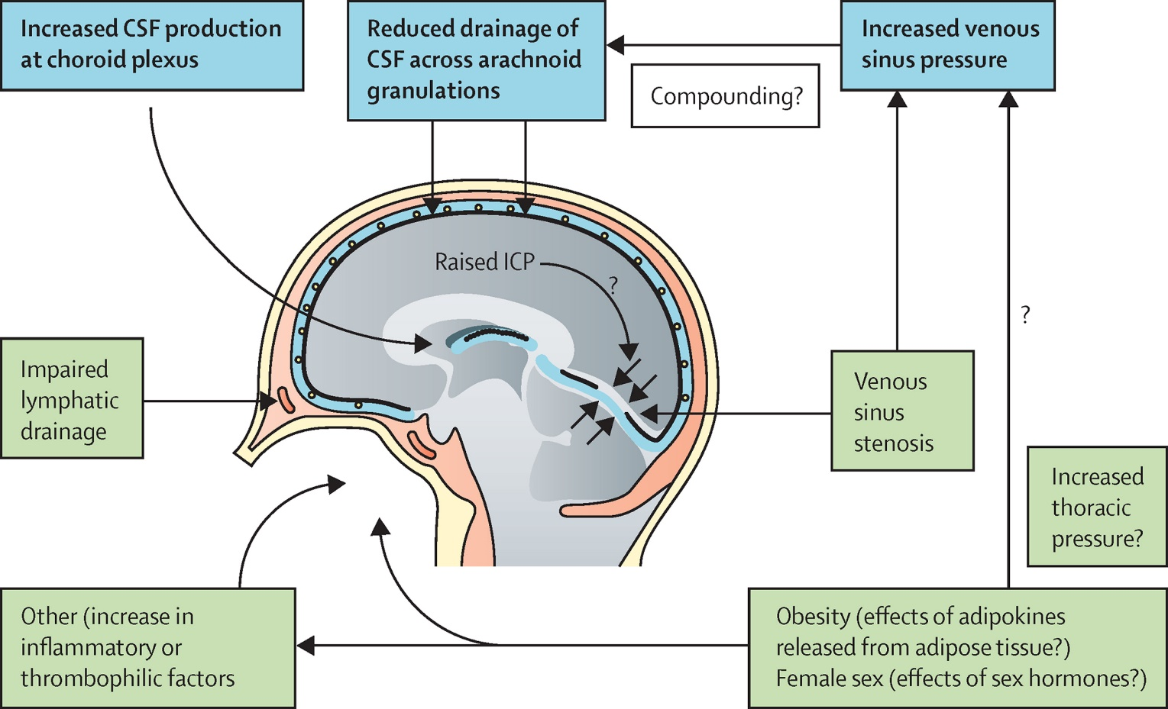
Figure 1
The Lancet Neurology 2016 15, 78-91DOI: (10.1016/S1474-4422(15)00298-7)
Copyright © 2016 Elsevier Ltd Terms and Conditions
Notes:
Alles lässt sich auf einige wenige sehr grundsätzliche Mechanismen zurückführen
Three main intracranial mechanisms have been suggested to result in raised intracranial pressure:
increased venous sinus pressure,
decreased CSF drainage across the arachnoid granulations or lymphatics,
and enhanced CSF production at the choroid plexus.
Being female and obese are two risk factors noted in idiopathic intracranial hypertension, suggesting a possible role for sex hormones and factors released by adipose tissue such as adipokines (cytokines released predominantly by adipose tissue), which could directly affect CSF dynamics. Other mechanisms, such as increased production of inflammatory or thrombophilic factors, might also be involved. Additionally, obesity has been suggested to raise intrathoracic pressure and, in conjunction with venous sinus stenosis, might increase venous sinus pressure. However, stenosis is probably a result of raised venous pressure rather than a cause.

Slide 88
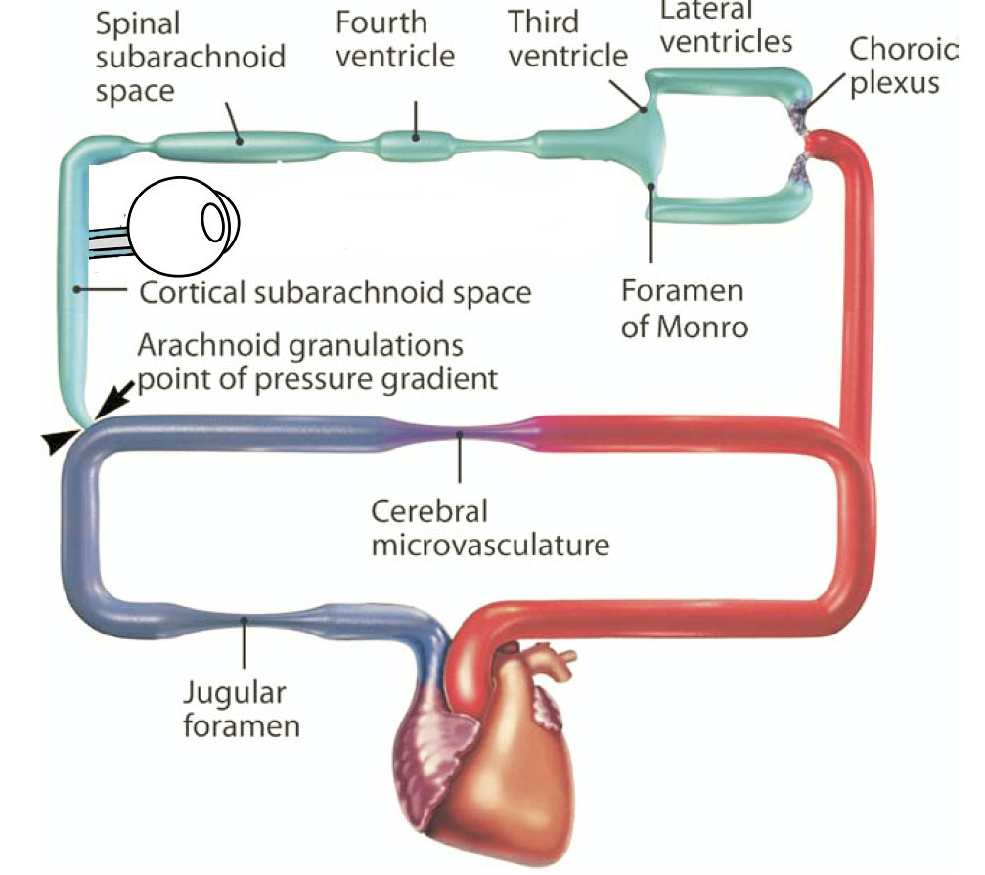
Mechanisms of CSF circulation
Adapted from: Grzybowski and Lubow. In: Ocular disease. Mechanisms and Management. 2010

Slide 89
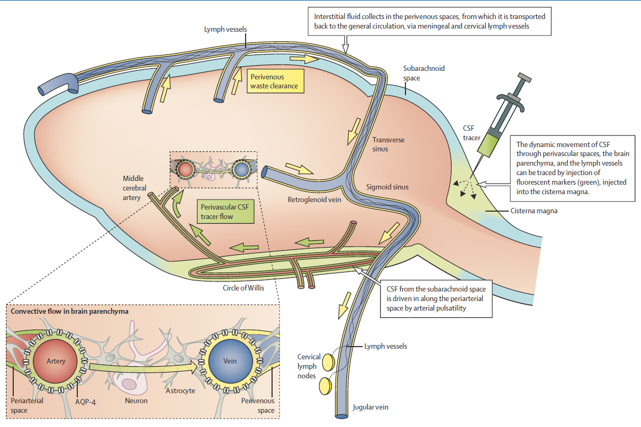
Glymphatic system!
Louveau A, Smirnov I, Keyes TJ, et al. Structural and functional features of central nervous system lymphatic vessels. Nature 2015; 523: 337–41.
Aspelund A, Antila S, Proulx ST, et al. A dural lymphatic vascular system that drains brain interstitial fluid and macromolecules. J Exp Med 2015; 212: 991–99.
Notes:
Daraus werden sich ziemlich sicher neue Ideen zur Pathophysiologie und Therapieansätzen entwickeln. Glymphatic system.

Slide 90
Papilledema
Box 7.1 Optic neuropathies associated with disc
edema
● Infectious (e.g., infectious optic neuritis, meningitis,
neuroretinitis, uveitis-associated disc edema, cat-scratch
disease, Lyme disease).
● Demyelinating (e.g., multiple sclerosis).
● Inflammatory (e.g., systemic lupus erythematosus,
sarcoidosis). 22
● Vascular (e.g., arteritic and nonarteritic anterior ischemic
optic neuropathy, diabetic papillopathy, central retinal vein
occlusion, and carotid-cavernous sinus fistula).
● Infiltrative (e.g., carcinomatous meningitis, sarcoidosis).
● Compressive (e.g., neoplastic, thyroid ophthalmopathy).
● Hereditary (e.g., Leber hereditary optic neuropathy).
● Traumatic (rare).
● Paraneoplastic optic neuropathy.
● Mechanical (e.g., hypotony).
● Chronic respiratory disease. 23
DOI: 10.1055/b-006-149927
Smith, Stacy V.; Lee, Andrew G.; Brazis, Paul W.: 2019 Clinical Pathways in Neuro-Ophthalmology
An Evidence-Based Approach Print ISBN 9781626232853 · Online ISBN 9781626232860

Slide 91
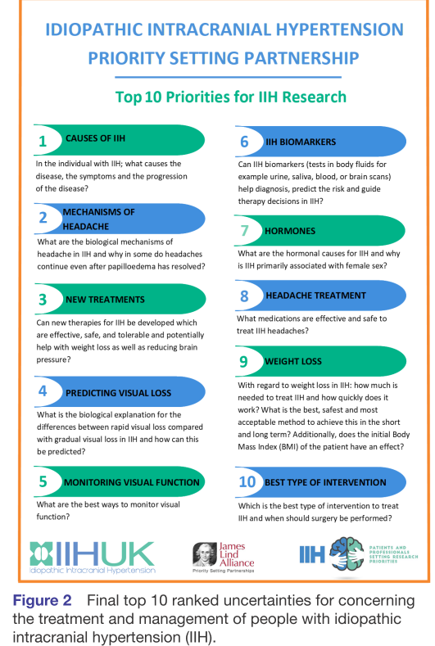
Research priorities
Mollan S, et al. BMJ Open 2019;9:e026573. doi:10.1136/bmjopen-2018-026573

Slide 92
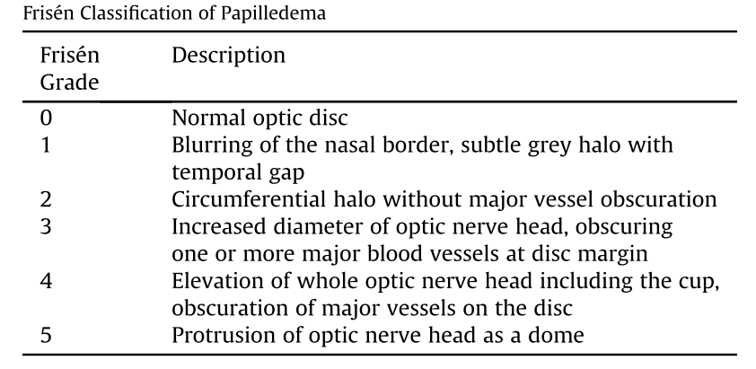
Frisen scale

Slide 93
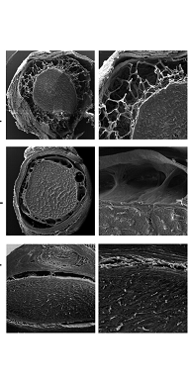
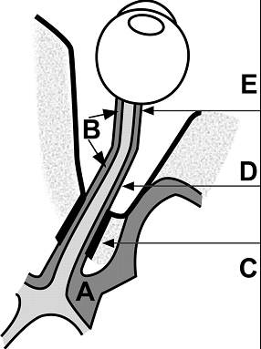

Perioptic Space
“a multichambered
and subdivided
tubular system
with a blind end
(cul de sac)
behind the ocular globe.”
Killer H E et al. Brain 2007;130:514-520
© The Author (2006). Published by Oxford University Press on behalf of the Guarantors of Brain. All rights reserved.
Notes:
Schematic representation of the CSF spaces surrounding the optic chiasm (intracranial CSF space) (A) and the CSF surrounding the optic nerve (orbital CSF space) (B). CSF flows from intracranial (A) into the SAS of the optic nerve (B). The SAS of the optic nerve is most narrow in the canalicular region (C). The intraorbital segment of the SAS is characterized by broad septae (D), whereas the retrobulbar segment is characterized by small trabeculae (E). Due to the CSF volume gradient the direction of flow is directed from the intracranial SAS to the orbital SAS.

